Slide 1
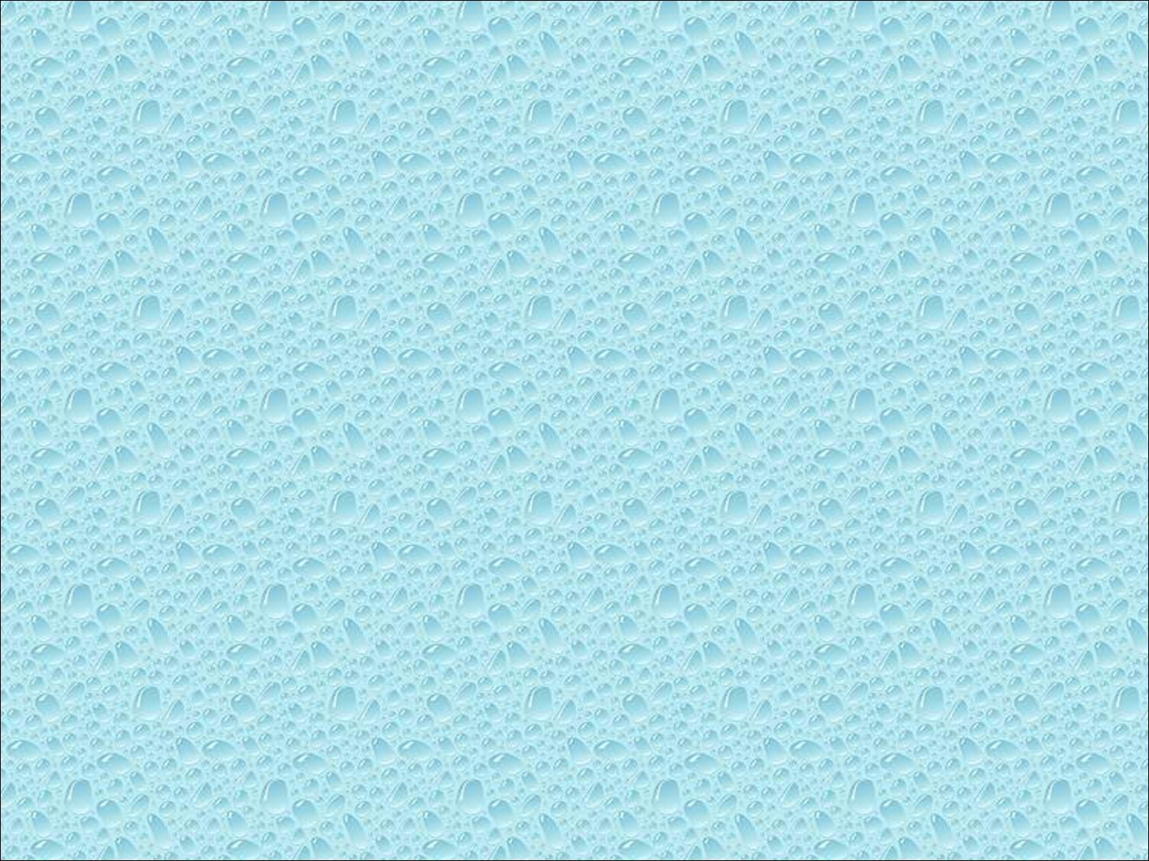

Part 2: Complete Programs

Slide 2

Refine the first program
  Alter the default values
  Introduce a standard program structure
Simple viewing
  Two-dimensional viewing as a special case of three-dimensional viewing
Fundamental OpenGL primitives
Attributes

Slide 3

Most OpenGL programs have a similar structure that consists of the following functions
  main():
    calls the defined callback functions
    opens one or more windows with the required properties
    enters event loop (last executable statement)
  init(): sets the state variables
    Viewing
    Attributes
  callbacks
    Display function
    Input and window functions

Slide 4

In this version, we shall see the same output but we have defined all the relevant state values through function calls using the default values
In particular, we set
  Colors
  Viewing conditions
  Window properties

Slide 5

includes gl.h
#include <GL/glut.h>
int main(int argc, char** argv)
{
glutInit(&argc,argv);
glutInitDisplayMode(GLUT_SINGLE|GLUT_RGB);
glutInitWindowSize(500,500);
glutInitWindowPosition(0,0);
glutCreateWindow("simple");
glutDisplayFunc(mydisplay);
init();
glutMainLoop();
}
define window properties
display callback
set OpenGL state
enter event loop

Slide 6

glutInit allows application to get command line arguments and initializes system
gluInitDisplayMode requests properties for the window (the rendering context)
  RGB color
  Single buffering
  Properties logically ORed together
glutWindowSize in pixels
glutWindowPosition from top-left corner of display
glutCreateWindow create window with title “simple”
glutDisplayFunc display callback
glutMainLoop enter infinite event loop

Slide 7

black clear color
void init()
{
glClearColor (0.0, 0.0, 0.0, 1.0);
glColor3f(1.0, 1.0, 1.0);
glMatrixMode (GL_PROJECTION);
glLoadIdentity ();
glOrtho(-1.0, 1.0, -1.0, 1.0, -1.0, 1.0);
}
opaque window
fill/draw with white
viewing volume

Slide 8

The units in glVertex are determined by the application and are called object or problem coordinates
The viewing specifications are also in object coordinates and it is the size of the viewing volume that determines what will appear in the image
Internally, OpenGL will convert to camera (eye) coordinates and later to screen coordinates
OpenGL also uses some internal representations that usually are not visible to the application

Slide 9

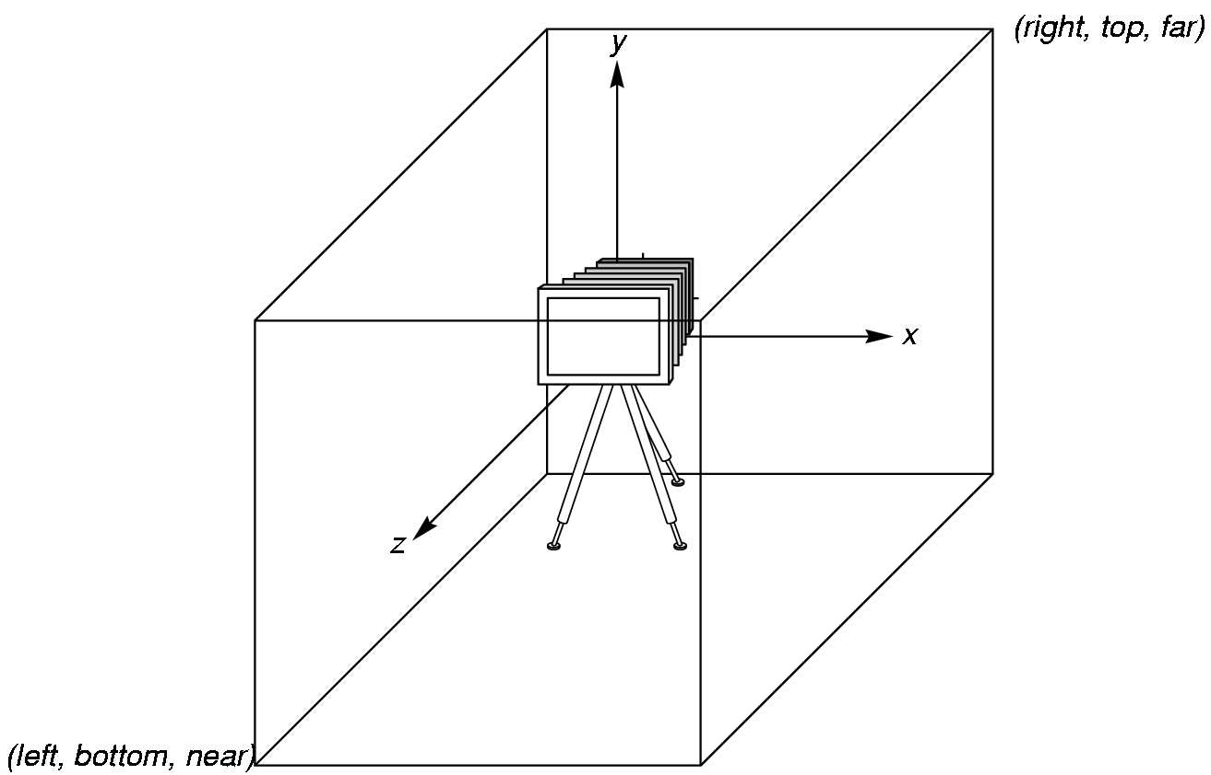
OpenGL places a camera at the origin in object space pointing in the negative z direction
The default viewing volume
is a box centered at the
origin with a side of
length 2

Slide 10

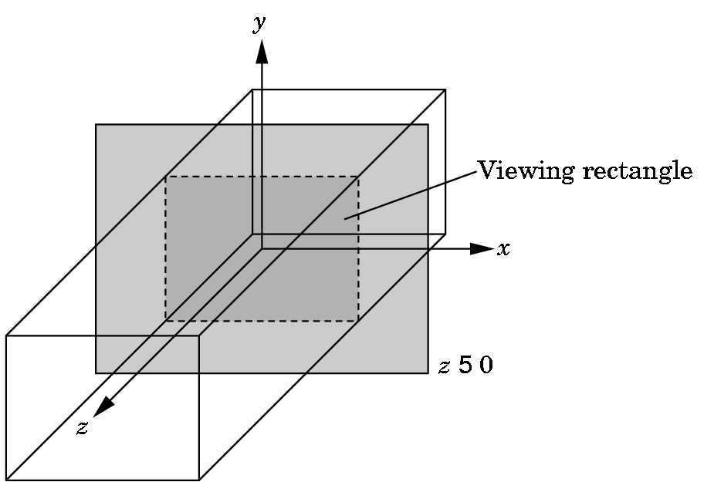
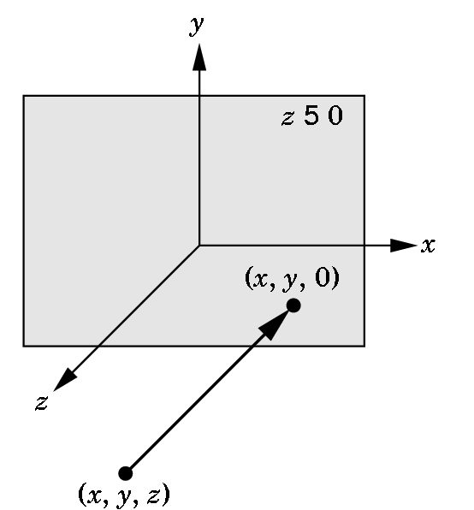
In the default orthographic view, points are
projected forward along the z axis onto the
plane z=0
z=0
z=0

Slide 11

In OpenGL, projection is carried out by a projection matrix (transformation)
There is only one set of transformation functions so we must set the matrix mode first
glMatrixMode (GL_PROJECTION)
Transformation functions are incremental so we start with an identity matrix and alter it with a projection matrix that gives the view volume
glLoadIdentity();
glOrtho(-1.0, 1.0, -1.0, 1.0, -1.0, 1.0);

Slide 12

In glOrtho(left, right, bottom, top, near, far) the near and far distances are measured from the camera
Two-dimensional vertex commands place all vertices in the plane z=0
If the application is in two dimensions, we can use the function
gluOrtho2D(left, right,bottom,top)
In two dimensions, the view or clipping volume becomes a clipping window

Slide 13

void mydisplay()
{
glClear(GL_COLOR_BUFFER_BIT);
glBegin(GL_POLYGON);
glVertex2f(-0.5, -0.5);
glVertex2f(-0.5, 0.5);
glVertex2f(0.5, 0.5);
glVertex2f(0.5, -0.5);
glEnd();
glFlush();
}

Slide 14

GL_POINTS
GL_POLYGON
GL_LINES
GL_LINE_STRIP
GL_LINE_LOOP
GL_TRIANGLES
GL_QUAD_STRIP
GL_TRIANGLE_STRIP
GL_TRIANGLE_FAN

Slide 15

Points
  glBegin (GL_POINTS);
  glVertex3f (x1, y1, z1);
  glVertex3f (x2, y2, z2);
  ......
  glEnd ();
glPointSize (float size);

Slide 16

Lines
  glBegin (GL_LINES);
  glVertex3f (x1, y1, z1);
  glVertex3f (x2, y2, z2);
  glVertex3f (x3, y3, z3);
  glVertex3f (x4, y4, z4);
  glEnd ();
glLineWidth (float width);
(x2, y2, z2)
(x1, y1, z1)
(x4, y4, z4)
(x3, y3, z3)

Slide 17
Line Strips
  glBegin (GL_LINE_STRIP);
  glVertex3f (x1, y1, z1);
  glVertex3f (x2, y2, z2);
  glVertex3f (x3, y3, z3);
  glVertex3f (x4, y4, z4);
  glEnd ();
(x4, y4, z4)
(x2, y2, z2)
(x1, y1, z1)
(x3, y3, z3)

Slide 18
Triangles
  glBegin (GL_TRIANGLES);
  glVertex3f (x1, y1, z1);
  glVertex3f (x2, y2, z2);
  glVertex3f (x3, y3, z3);
  glEnd ();
(x3, y3, z3)
(x1, y1, z1)
(x2, y2, z2)

Slide 19
Triangle Strips
  glBegin (GL_TRIANGLE_STRIP);
  glVertex3f (x1, y1, z1);
  glVertex3f (x2, y2, z2);
  glVertex3f (x3, y3, z3);
  glVertex3f (x4, y4, z4);
  glVertex3f (x5, y5, z5);
  glEnd ();

Slide 20
Quads
  glBegin (GL_QUADS);
  ......
  glEnd ();
Quad Strips
  glBegin (GL_QUAD_STRIP);
  ......
  glEnd ();

Slide 21
Polygon Modes
  glPolygonMode (GL_FRONT_AND_BACK, GL_LINE);
  glPolygonMode (GL_FRONT_AND_BACK, GL_FILL);
Hidden Surface Removal
  glEnable (GL_DEPTH_TEST);
  glDisable (GL_DEPTH_TEST);

Slide 22

OpenGL will only display polygons correctly that are
  Simple: edges cannot cross
  Convex: All points on line segment between two points in a polygon are also in the polygon
  Flat: all vertices are in the same plane
User program can check if above true
  OpenGL will produce output if these conditions are violated but it may not be what is desired
Triangles satisfy all conditions
nonconvex polygon
nonsimple polygon

Slide 23

Indicates whether a vertex should be considered as initializing a boundary edge of a polygon.
If flag of a vertex is set GL_TRUE (default), the vertices created are considered to precede boundary edges until this function is called again with flag GL_FALSE.

Slide 24

glBegin(GL_POLYGON)
glEdgeFlag(GL_TRUE);
glVertex3fv(V1);
glEdgeFlag(GL_FALSE);
glVertex3fv(V2);
glEdgeFlag(GL_TRUE);
glVertex3fv(V3);
glEnd()
V1
V2
V3

Slide 25

Attributes are part of the OpenGL state and determine the appearance of objects
  Color (points, lines, polygons)
  Size and width (points, lines)
  Stipple pattern (lines, polygons)
  Polygon mode
    Display as filled: solid color or stipple pattern
    Display edges
    Display vertices

Slide 26

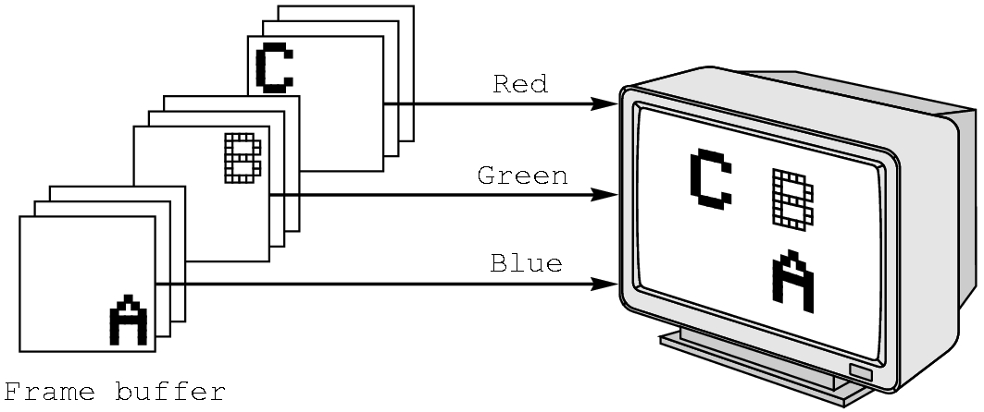
Each color component is stored separately in the frame buffer
Usually 8 bits per component in buffer
Note in glColor3f the color values range from 0.0 (none) to 1.0 (all), whereas in glColor3ub the values range from 0 to 255

Slide 27

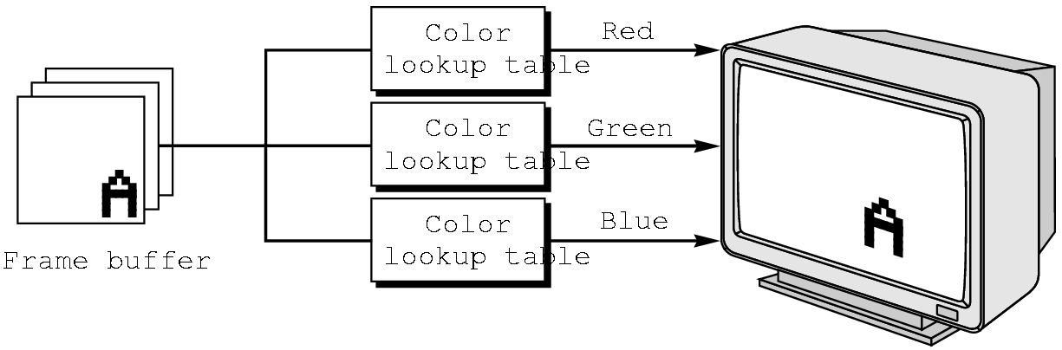
Colors are indices into tables of RGB values
Requires less memory
  indices usually 8 bits
  not as important now
    Memory inexpensive
    Need more colors for shading

Slide 28

The color as set by glColor becomes part of the state and will be used until changed
  Colors and other attributes are not part of the object but are assigned when the object is rendered
We can create conceptual vertex colors by code such as
glColor
glVertex
glColor
glVertex

Slide 29

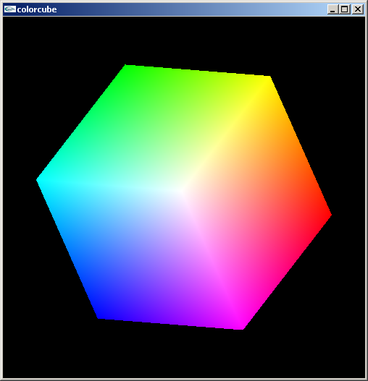
Default is smooth shading
  OpenGL interpolates vertex colors across visible polygons
Alternative is flat shading
  Color of first vertex
  determines fill color
glShadeModel
  (GL_SMOOTH)
  or GL_FLAT

Slide 30

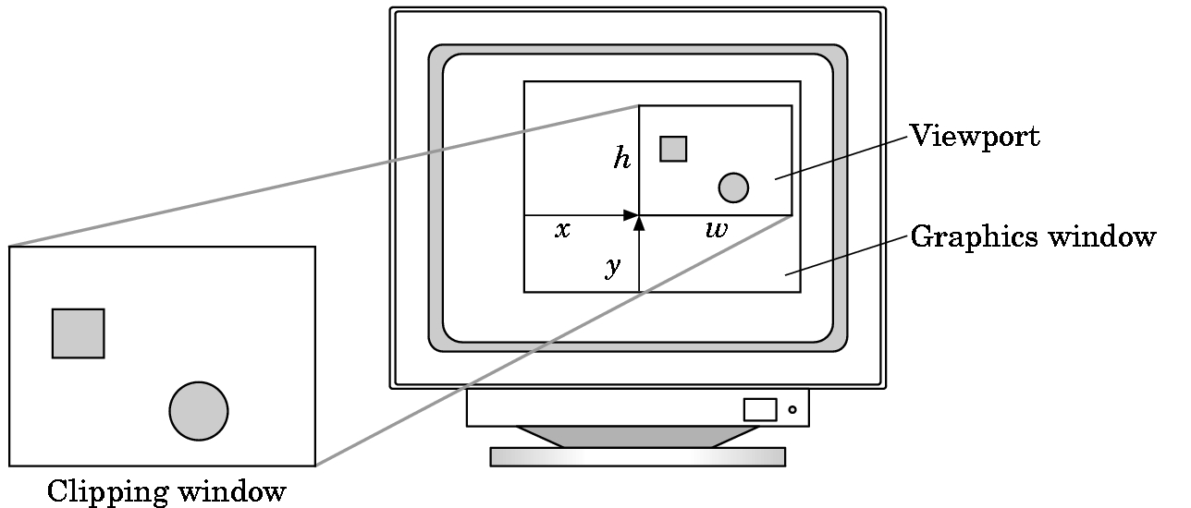
Do not have use the entire window for the image: glViewport(x,y,w,h)
Values in pixels (screen coordinates)

